Slide 1
Bus Transit Performance
Team A
By
AlHasan Bahaidarah, Salma Alali, Isaac Chan, Tiansui Gu, Jasmine Fanchu Zhou
Notes:
Team Members:
AlHasan Bahaidarah
Salma Alali
Jasmine Fanchu Zhou
Isaac Chan
Tiansui Gu

Slide 2
Project Overview
Project motivation: Examining the disparity in bus performance trends based on geographical location
Goal: Extract information that highlights such disparities to address fixing these issues going forward.
Background needed: Public transportation context knowledge and measurement metrics

Slide 3
Progress: (meetings, data analysis)
Each member has worked on their respective base question for the project. Helping each other out with each other’s data cleaning process and brainstorming together in meetings to come up with logical ways to deal with the info given.
Division of work:
Primarily base question per member, but some team members worked as a subgroup to answer a question together.
Data used:
Census Neighbourhood data
MBTA Bus transit reliability
MBTA GTFS-Map (Mapping stops to neighbourhoods)

Slide 4
Results and Visualizations Per Base Question
End-to-end travel times for different bus routes
Existence of disparities in the service levels of different routes
Population sizes and characteristics of communities serviced by different bus routes (e.g. race, ethnicity, age, people with disabilities/ vulnerabilities)
Differences in the characteristics of the people most impacted by disparities
Which neighborhoods are served better/worse by the MTBA bus system, which routes are better/worse, differences in quality of service by class/race, contributing variables, ect.

Slide 5
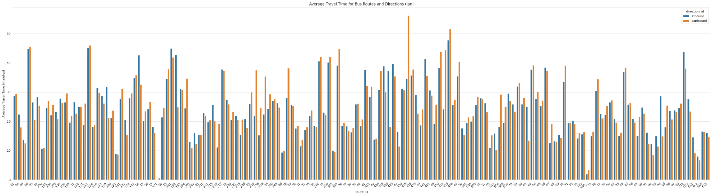
Base Question 1: End-to-End times for Bus Routes
Notes:
We extracted and graphed the end to end times for every route and found that most inbound and outbound routes have similar times.

Slide 6
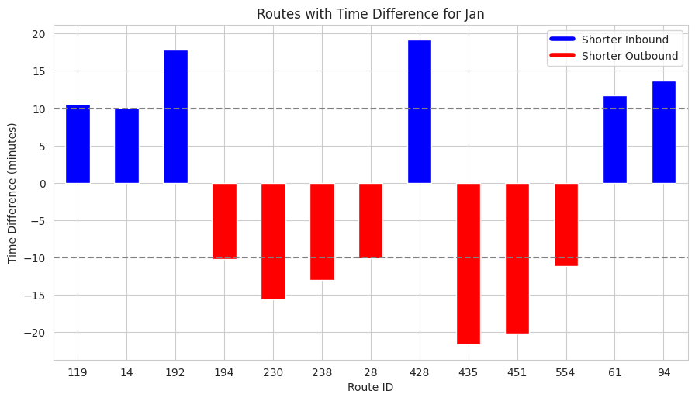
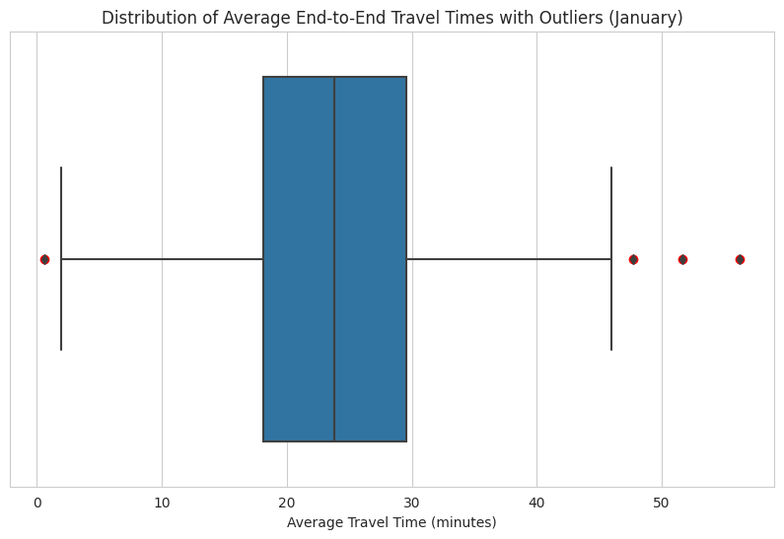
Base Question 1: End-to-End times for Bus Routes
Found a few outliers
Using Interquartile Range (IQR)
Difference between the first and third quartiles
Derived important values
Median, whiskers, IQR

Slide 7
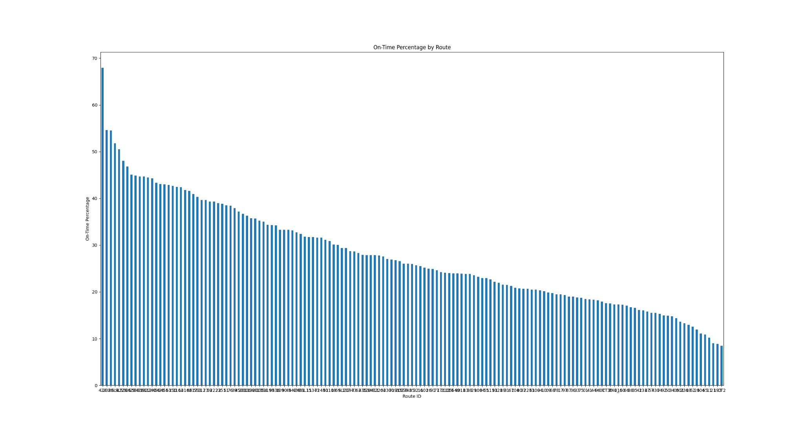
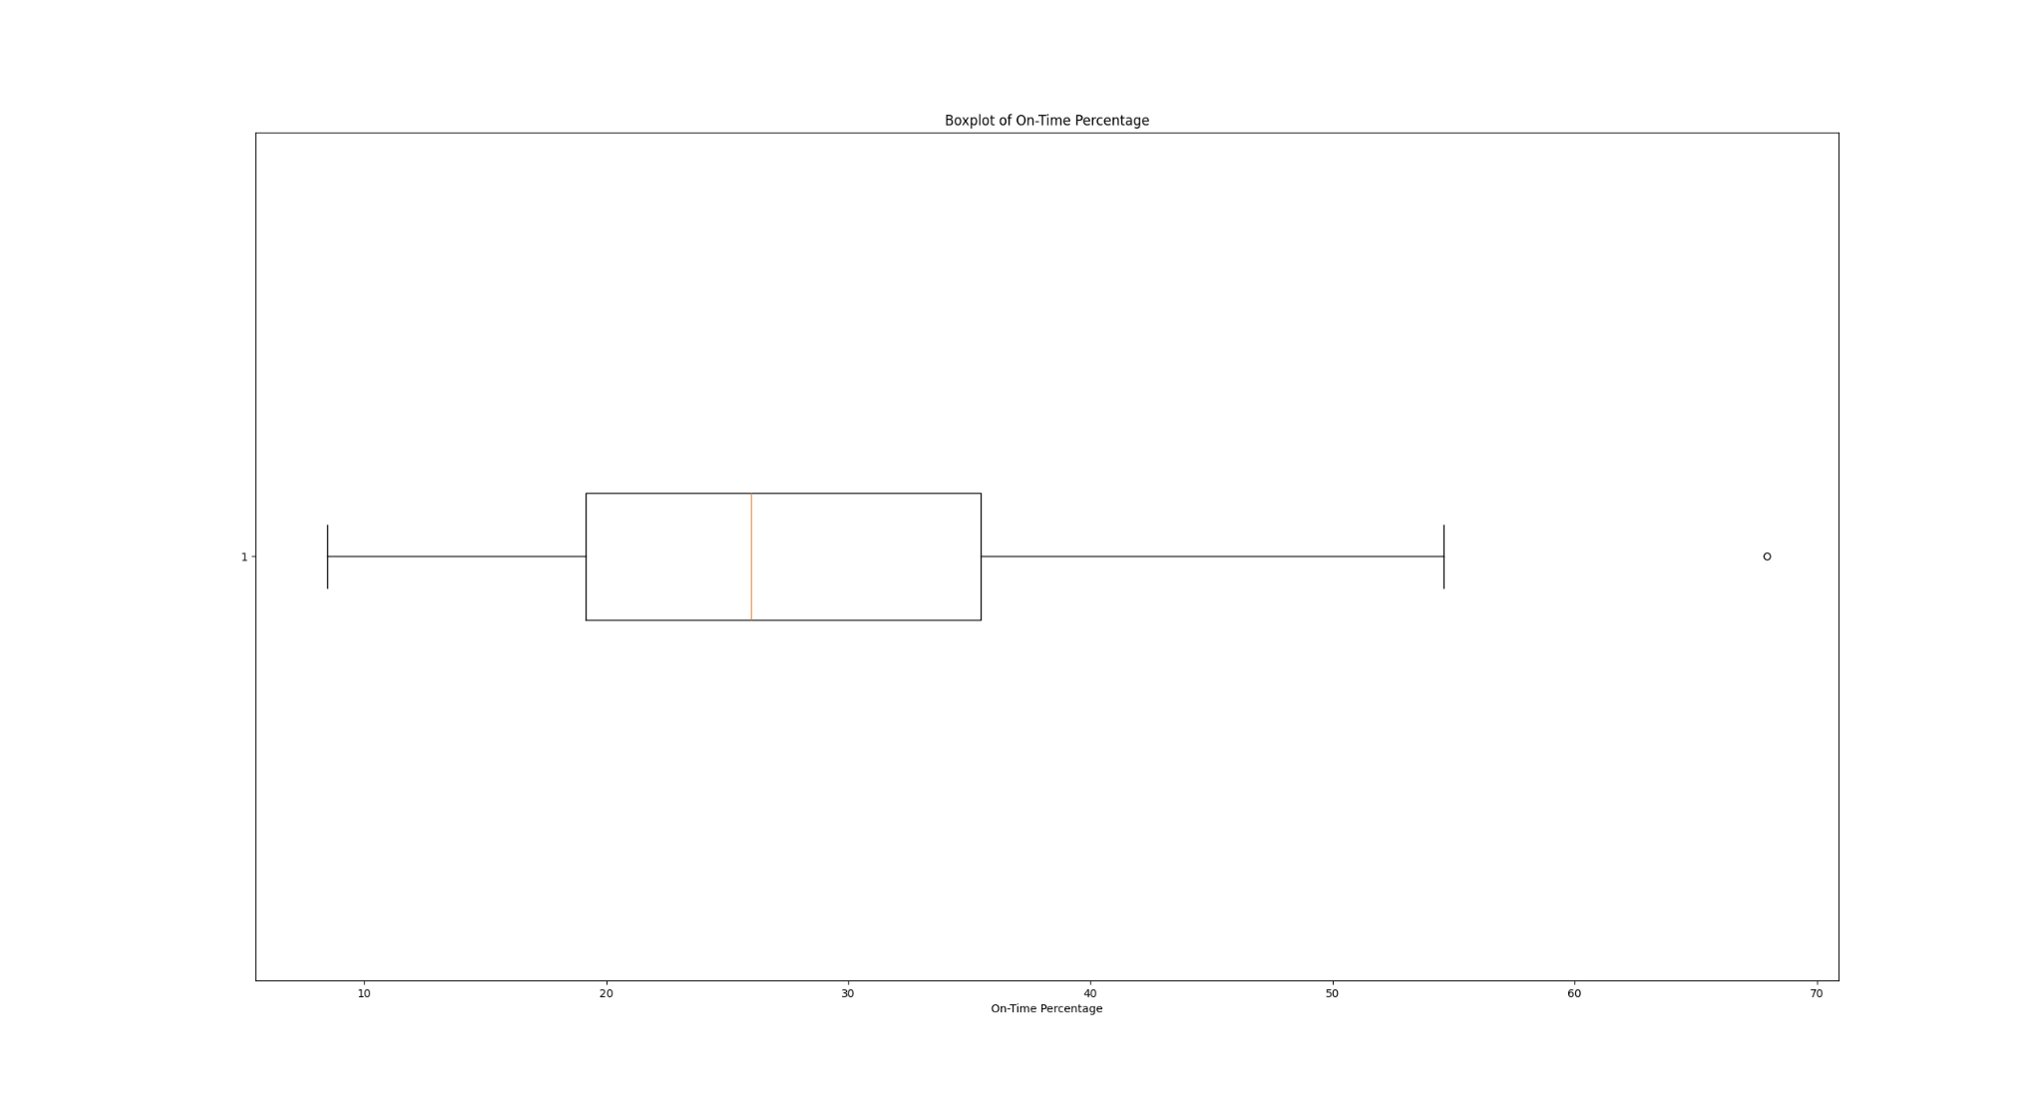
Base Question 2: Existence of disparities in the service levels of routes
Prediction Accuracy
Only very few routes has exceeded 50% of accuracy rate
Most routes has a 20~40% accuracy rate

Slide 8
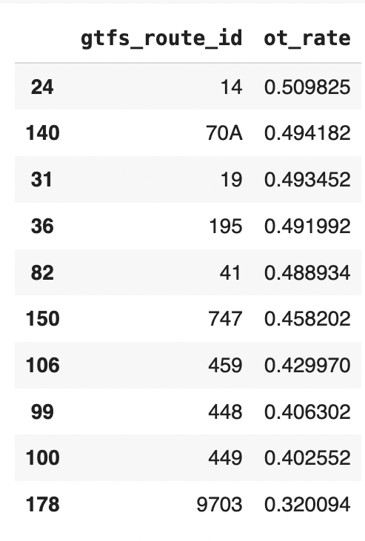
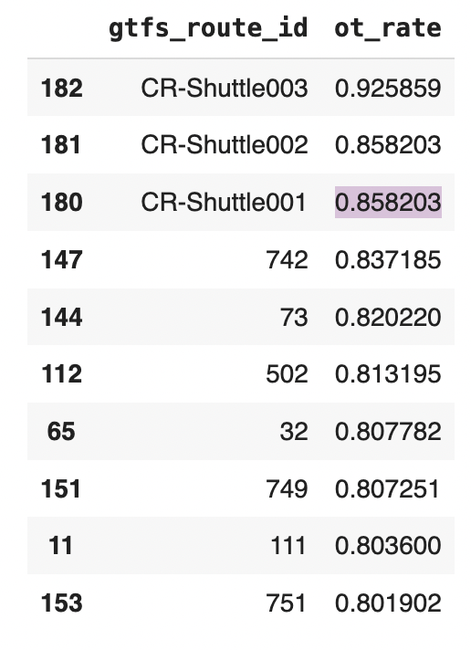
Base Question 2: Existence of disparities in the service levels of routes
Bus Reliability
New variable: rate of on-time (ot_rate) by dividing the otp_denominator from the otp_nominator.
Find the Top 10 and Bottom 10 on-time performance bus route
Top 10 routes are on the north side of Boston

Slide 9
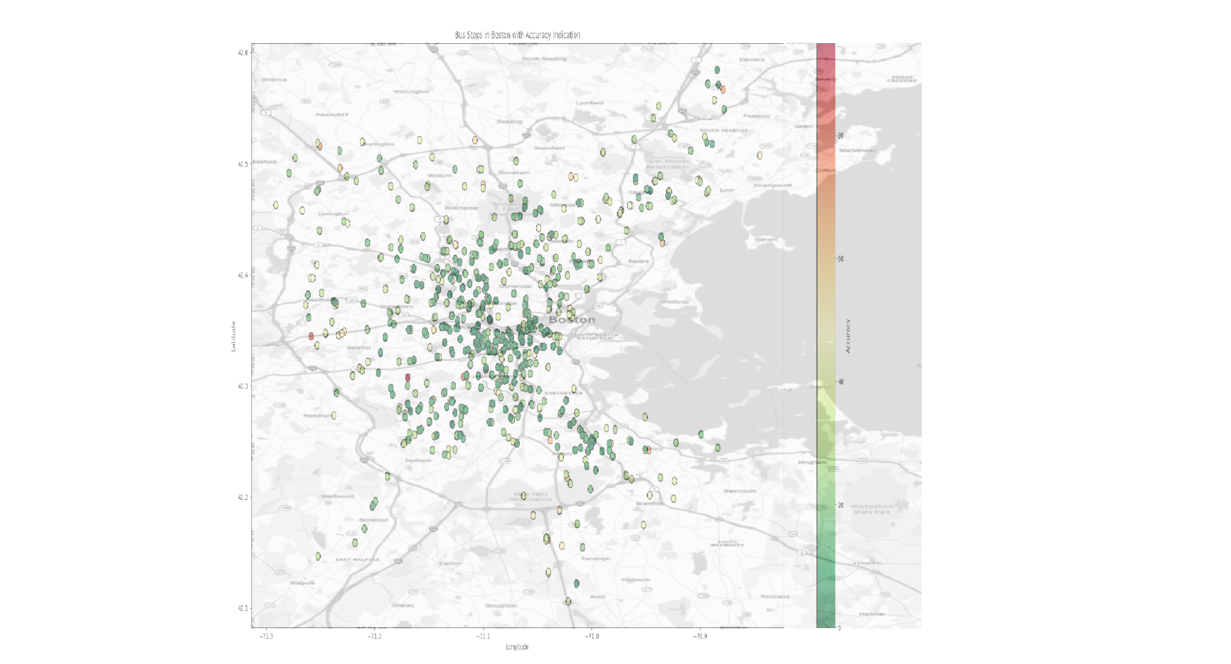
Base Question 3: Characteristics of communities serviced by routes
The graph for stop distributions in Boston metropolitan area
Green means worse on-time rate, Red mean better on-time rate
We can see that most stations clusters at center of city, and they have poor on-time performance
Further information on race, age and disability is needed

Slide 10
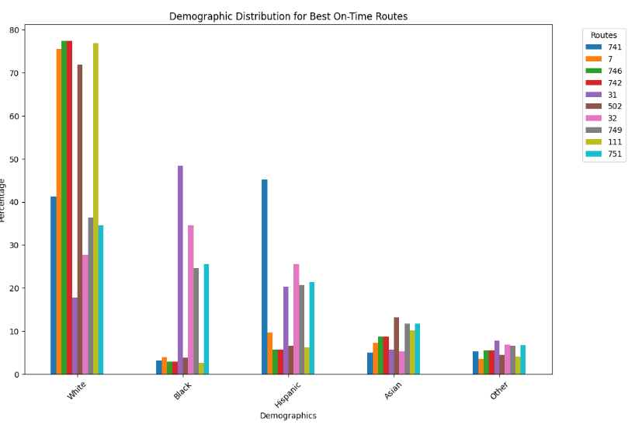
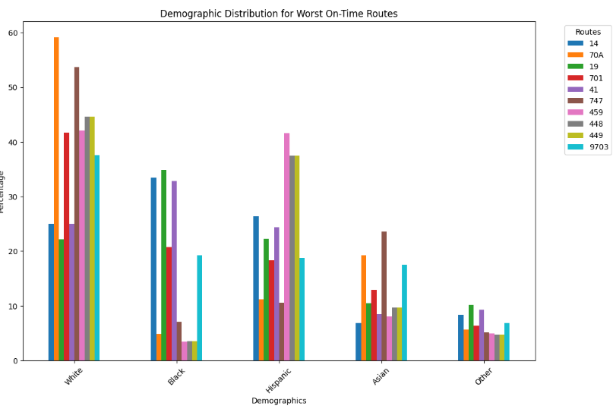
Base Question 4: Differences in the characteristics of the people most impacted by disparities
Two datasets: Massachusetts Census Data, MBTA System-wide GTFS Map
Based on demographic data and university rates
Added new column for averages

Slide 11
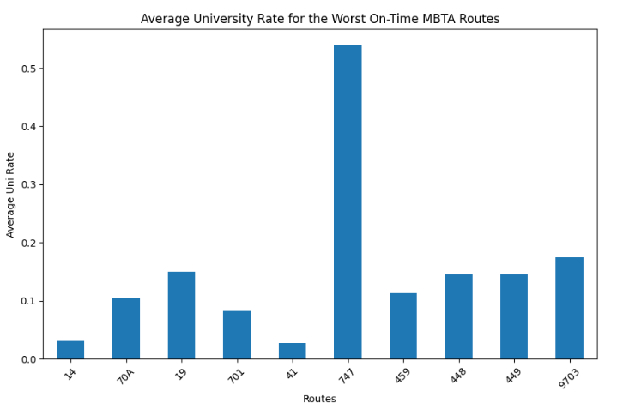
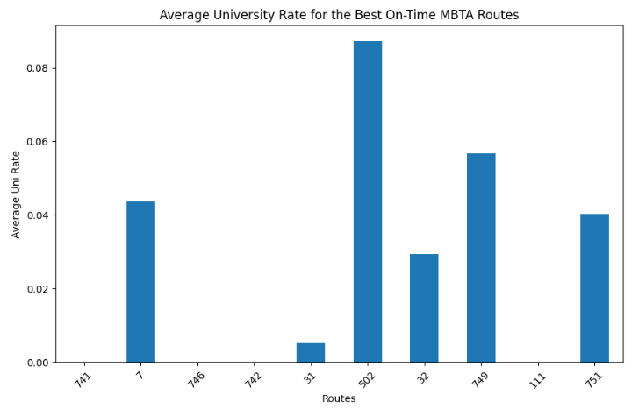

Slide 12
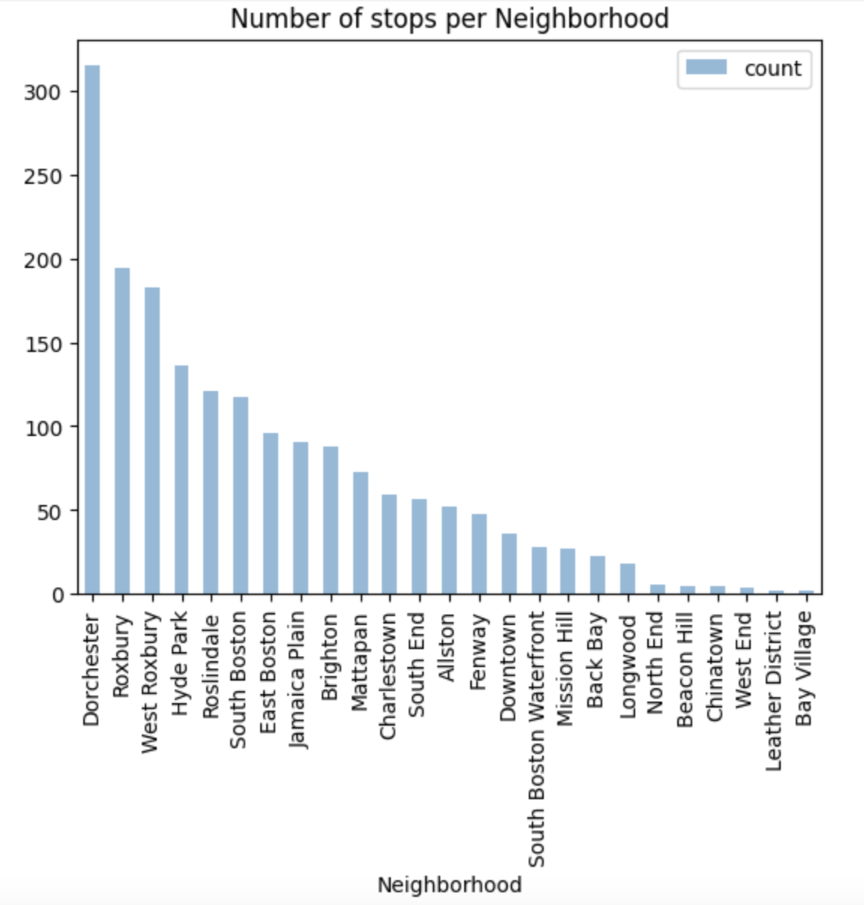
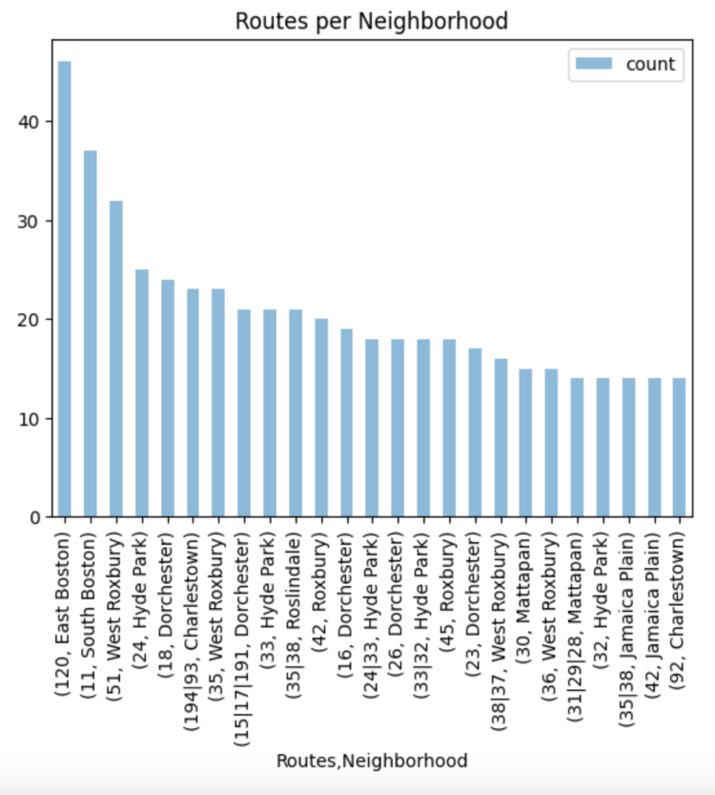
Base Question 5: Which neighbourhoods served better or worse

Slide 13
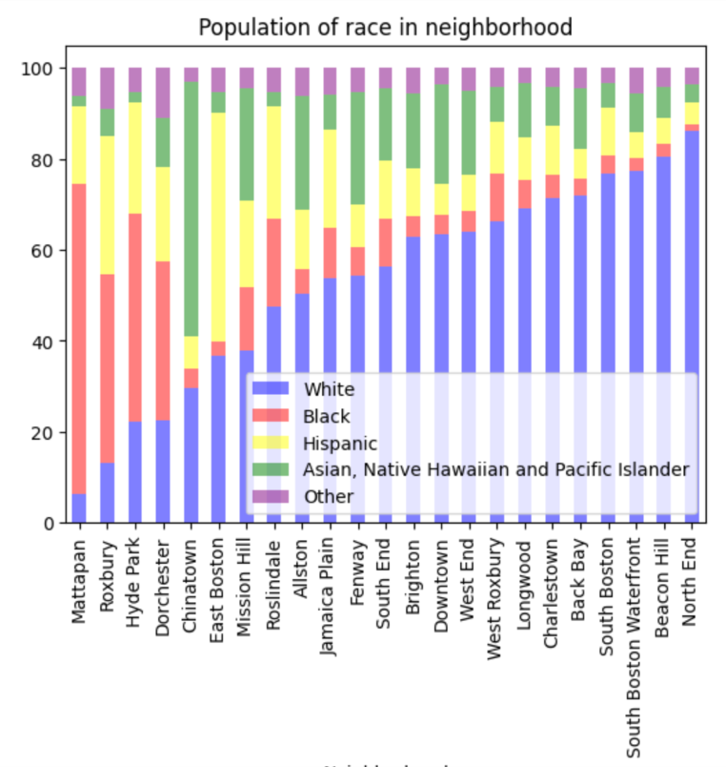
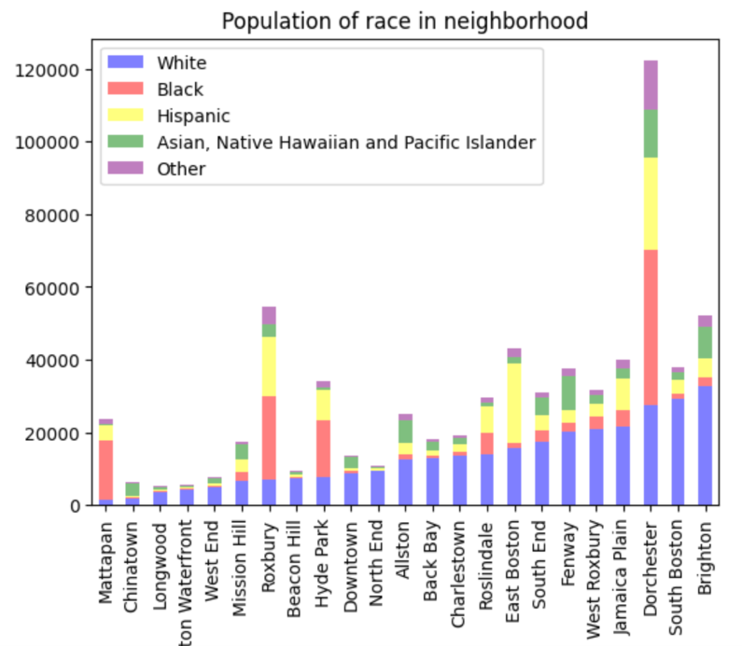
Here we see the demographic distribution of the races in the neighborhoods.

Slide 14
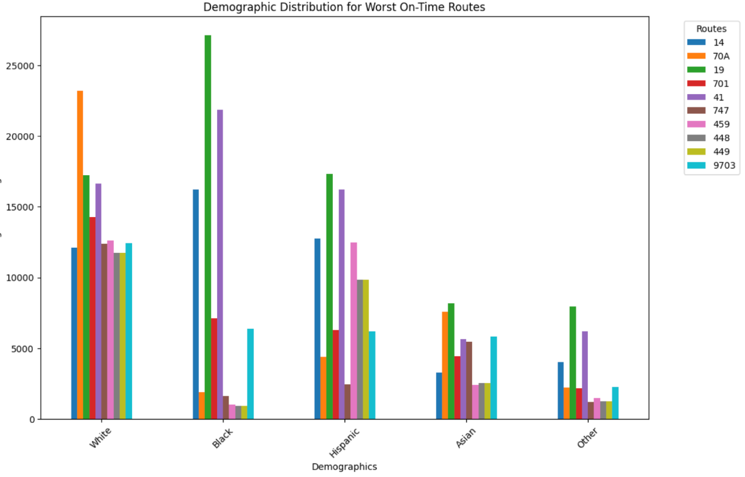
Count of people affected by this service disparity

Slide 15
Challenges working with data
Base Questions are relatively similar to one another, working individually was redundant
Difficulty in finding a dataset to merge MBTA related data with Census data.
Data is not well-documented, or had data missing with difficulties in interpretation of null values.
Some routes documented in the dataset cannot be located with current MBTA system. Reasons to be investigated.

Slide 16
Additional Challenges
Trouble coordinating meetups on account of very conflicting schedules.
Communication difficulties creating redundancy in work or unnecessary delays.
Datasets used are scattered and unclear on account of work being primarily individual.
Correlation not causation.

Slide 17
Assumptions and Limitations with data
Assumptions:
Trips ending before endpoints were excluded (end-to-end travel time question)
Census Neighbourhood data doesn’t represent the ratios of bus usage for each demographic.
Limitation:
No self-reported surveys of service in neighbourhoods
No clear methods to study service quality.
Neighbourhood is too big for measuring the impact of bus performance. For example, one may not use a bus line that is 15 min walk from his home, even though the stop and his home may technically be in the same neighbourhood.

Slide 18
Extension Project
Correlating the performance of the bus and train stops to their locations on the map such that we could measure the performance by clusters of the stops instead of neighborhoods
Rationale: There are disparities in service levels, for example route to route. This would help us realize where the bottleneck stops are and suggest modification in stops of routes or rerouting existing trips.
Questions for Analysis: Find data that shows the need for more stations for certain areas instead of others. Curious about people changing stations. Hypotheses: Creating routes that twist and turn can make the public transportation of the city better
Data Sets & Sources: Lat-Lon data on bus stops: https://mbta-massdot.opendata.arcgis.com/datasets/MassDOT::mbta-systemwide-gtfs-map/explore?layer=4&location=42.260770%2C-71.128336%2C10.96&showTable=true
Data Visualizations:
Clusters on a map of Boston, where dense clusters point to stops that have the highest foot traffic. Bigger clusters in size will represent more stations as in representing less foot traffic per station.

Slide 19
Thank you!

